Slide 1


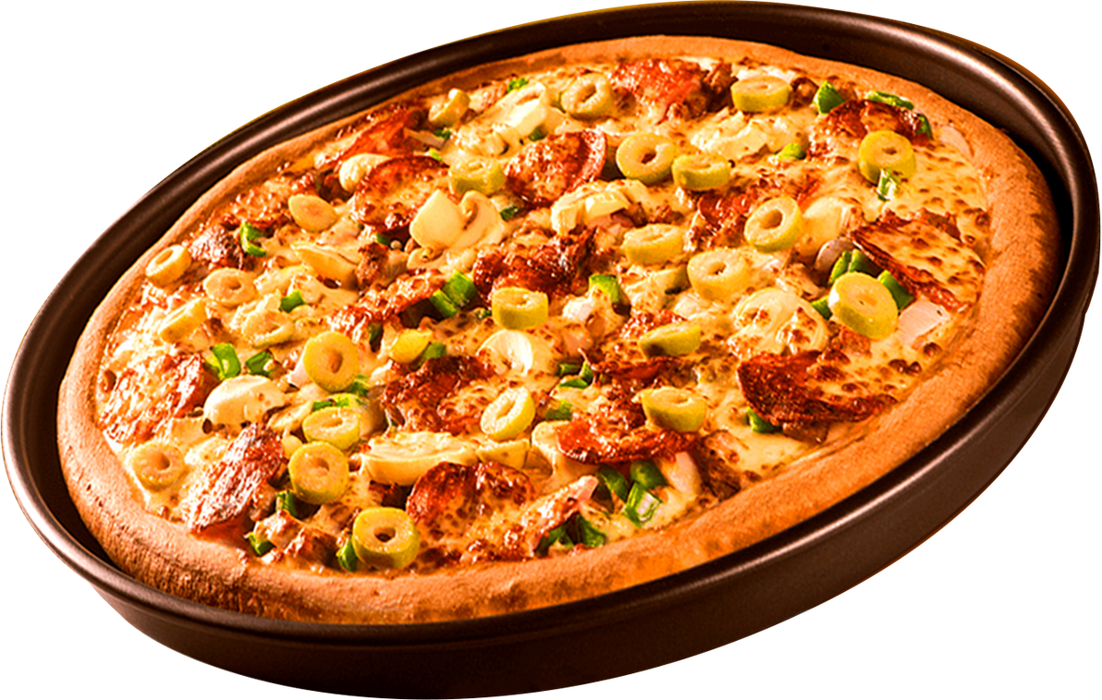


SHODWE
Home
About
Contact
PIZZA
SALES
ANALYSIS
WHERE EVERY SLICE TELLS A STORY

Slide 2

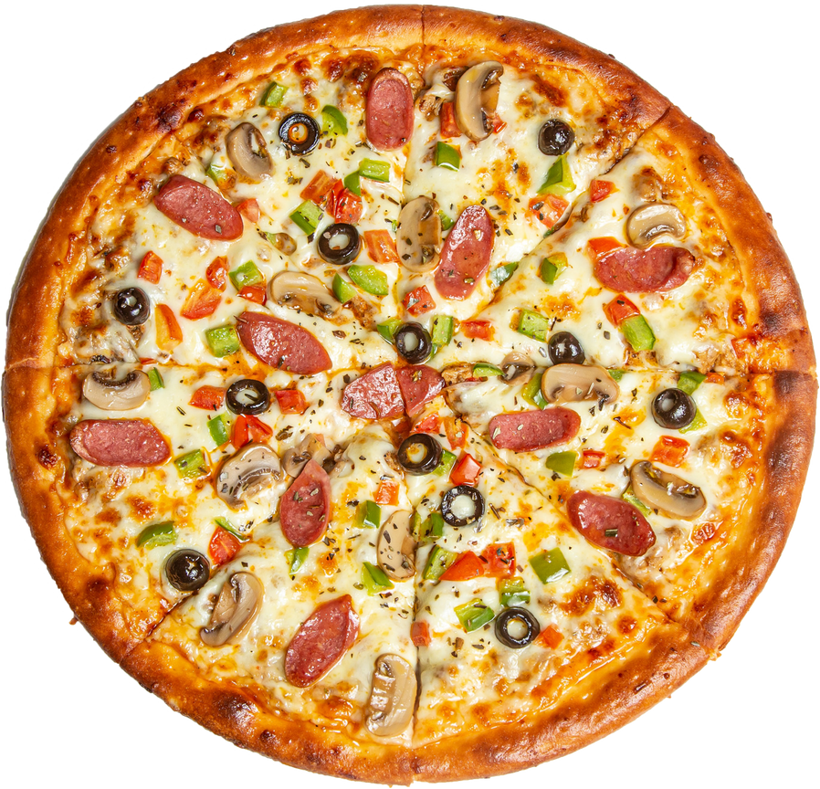
SHODWE
Home
About
Contact
ABOUT
Hello, My name is Jatin.
In this pizza sales analysis project, I utilized SQL queries to analyze pizza sales data, providing insights into customer preferences, revenue generation, and ordering trends.

Slide 3
SHODWE
Home
About
Contact
KEY OBJECTIVES
01
UNDERSTAND SALES PERFORMANCE AND REVENUE TRENDS.
02
IDENTIFY THE BEST-SELLING PIZZA SIZES, TYPES, AND CATEGORIES.
03
ANALYZE ORDER DISTRIBUTION BY TIME.
04
DETERMINE REVENUE CONTRIBUTIONS OF DIFFERENT PIZZAS.

Slide 4

SHODWE
Home
About
Contact
SQL IMPLEMENTATION
DATABASE AND TABLE CREATION:
Category-wise Pizza Distribution: Analyzed pizza sales by category.
Orders by Hour: Evaluated peak ordering times.
Daily Average Pizza Orders: Calculated the average number of pizzas sold per day.
Top 3 Revenue-Generating Pizzas: Identified the most profitable pizzas.
Revenue Contribution by Category: Determined each category's percentage contribution to overall revenue.
Cumulative Revenue Analysis: Tracked revenue growth over time.
Category-Wise Top 3 Revenue-Generating Pizzas: Identified the top-selling pizzas in each category.
Designed and structured tables for orders, order_details, pizzas, and pizza_types.
2. DATA RETRIEVAL & INSIGHTS:
Total Orders Placed: Counted the total number of orders.
Total Revenue: Summed up the total sales generated.
Most Expensive Pizza: Identified the highest-priced pizza.
Most Ordered Pizza Size: Determined the most frequently ordered pizza size.
Top 5 Most Ordered Pizza Types: Found the best-selling pizzas by quantity.

Slide 5
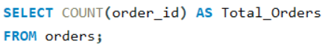
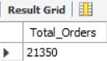
SHODWE
Home
About
Contact
RETRIEVE THE TOTAL NUMBER OF TOTAL PLACED.

Slide 6
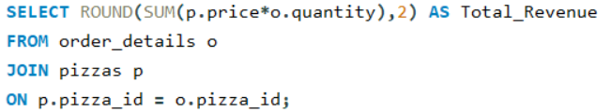
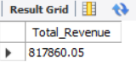
SHODWE
Home
About
Contact
CALCULATE THE TOTAL REVENUE GENERATED FROM PIZZA SALES.

Slide 7
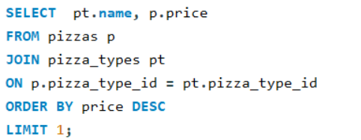
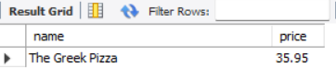
SHODWE
Home
About
Contact
IDENTIFY THE HIGHEST-PRICE PIZZA.

Slide 8
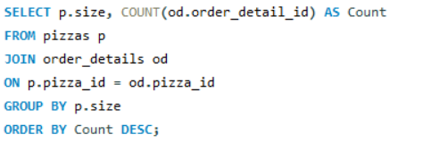
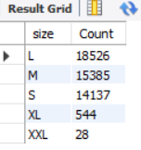
SHODWE
Home
About
Contact
IDENTIFY THE MOST COMMON PIZZA SIZE ORDERED.

Slide 9
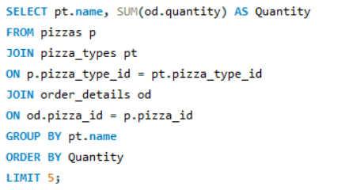
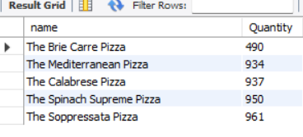
SHODWE
Home
About
Contact
LIST THE TOP 5 MOST ORDERED PIZZA TYPES ALONG WITH THEIR QUANTITIES.

Slide 10
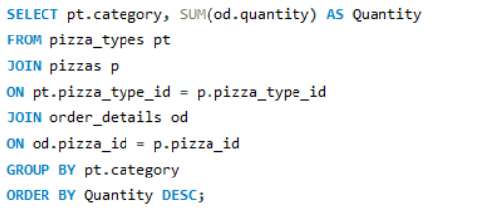
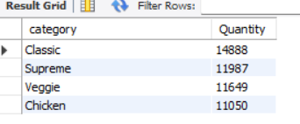
SHODWE
Home
About
Contact
JOIN THE NECESSARY TABLES TO FIND THE TOTAL QUANTITY OF EACH PIZZA CATEGORY.

Slide 11
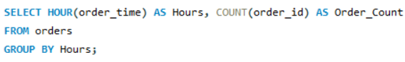
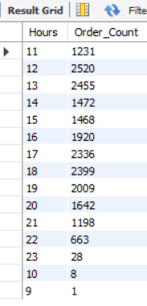
SHODWE
Home
About
Contact
DETERMINE THE DISTRIBUTION OF ORDERS BY HOUR OF THE DAY.

Slide 12
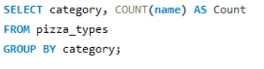
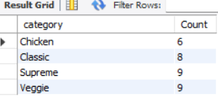
SHODWE
Home
About
Contact
JOIN RELEVENT TABLES TO FIND THE CATEGORY WISE DISTRIBUTION OF PIZZAS.

Slide 13
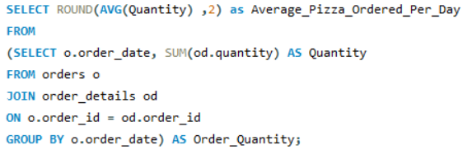
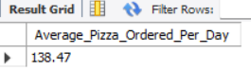
SHODWE
Home
About
Contact
GROUP THE ORDERS BY DATE AND CALCULATE THE AVERAGE NUMBER OF PIZZAS ORDERED PER DAY.

Slide 14
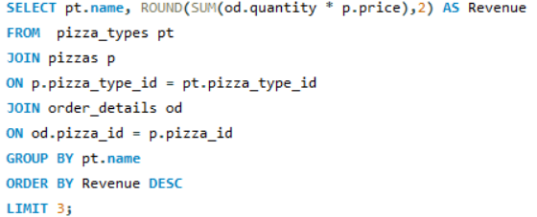
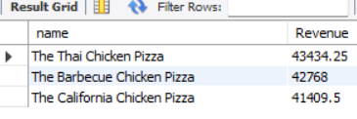
SHODWE
Home
About
Contact
DETERMINE THE TOP 3 MOST ORDERED PIZZA TYPES BASED ON REVENUE.

Slide 15
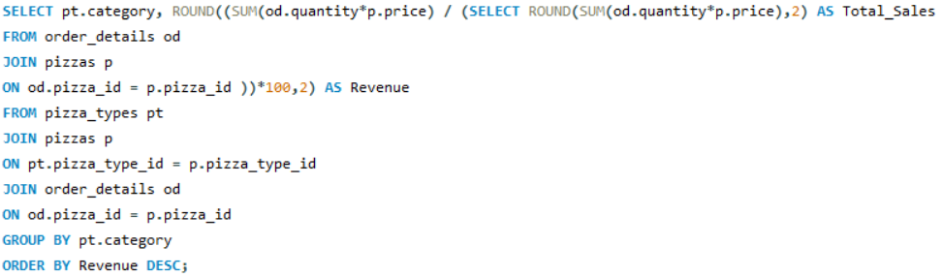
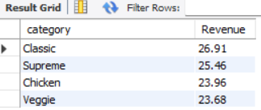
SHODWE
Home
About
Contact
CALCULATE THE PERCENTAGE CONTRIBUTION OF EACH PIZZA TYPE TO TOTAL REVENUE

Slide 16
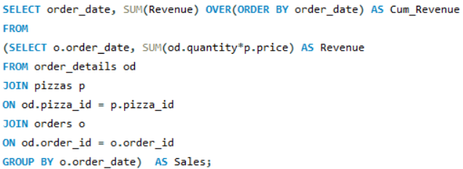
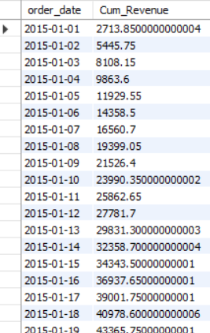
SHODWE
Home
About
Contact
ANALYZE THE CUMULATIVE REVENUE GENERATED OVER TIME.

Slide 17
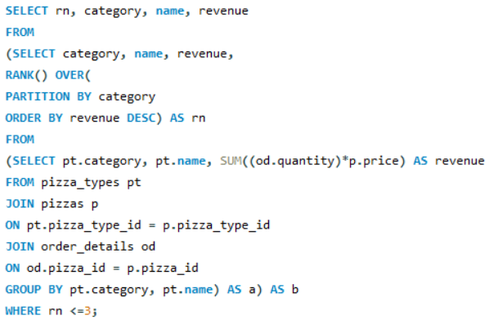
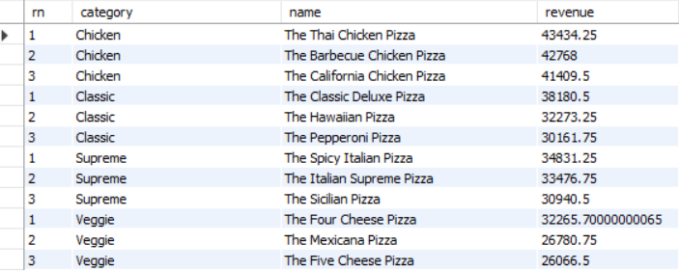
SHODWE
Home
About
Contact
DETERMINE THE TOP 3 ORDERED PIZZA TYPES BASED ON REVENUE FOR EACH PIZZA CATEGORY.

Slide 18
SHODWE
Home
About
Contact
CONCLUSION
THIS PROJECT SHOWCASES HOW SQL CAN BE LEVERAGED TO ANALYZE AND OPTIMIZE PIZZA SALES, OFFERING VALUABLE INSIGHTS FOR BUSINESS DECISION-MAKING.

Slide 19
SHODWE
Home
About
Contact
THANK YOU
THANK YOU FOR YOUR TIME AND ATTENTION
I APPRECIATE THE OPPORTUNITY TO SHOWCASE MY SQL-DRIVEN PIZZA SALES ANALYSIS PROJECT.

